Slide 1
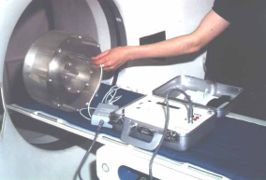

Slide 2
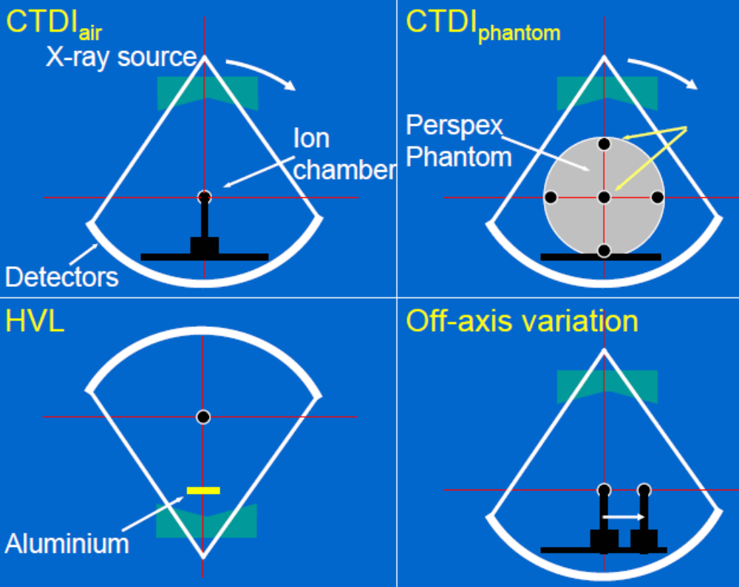



Slide 3
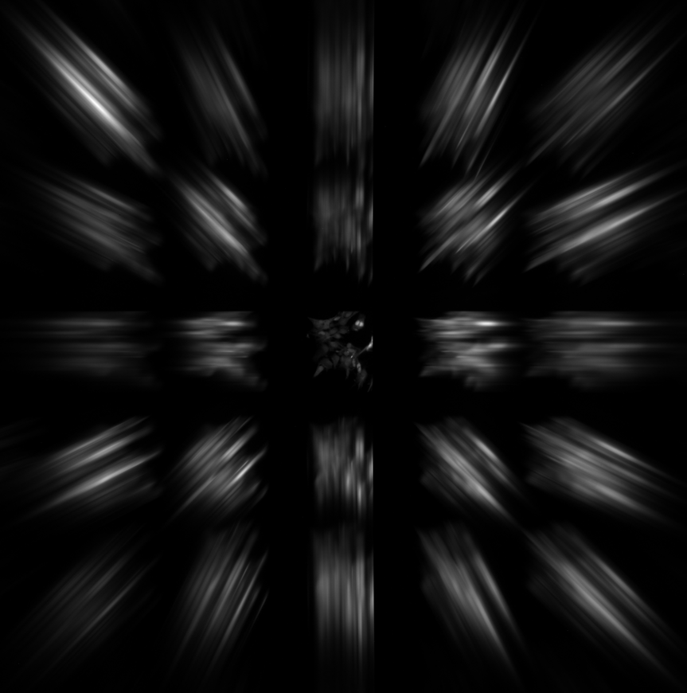
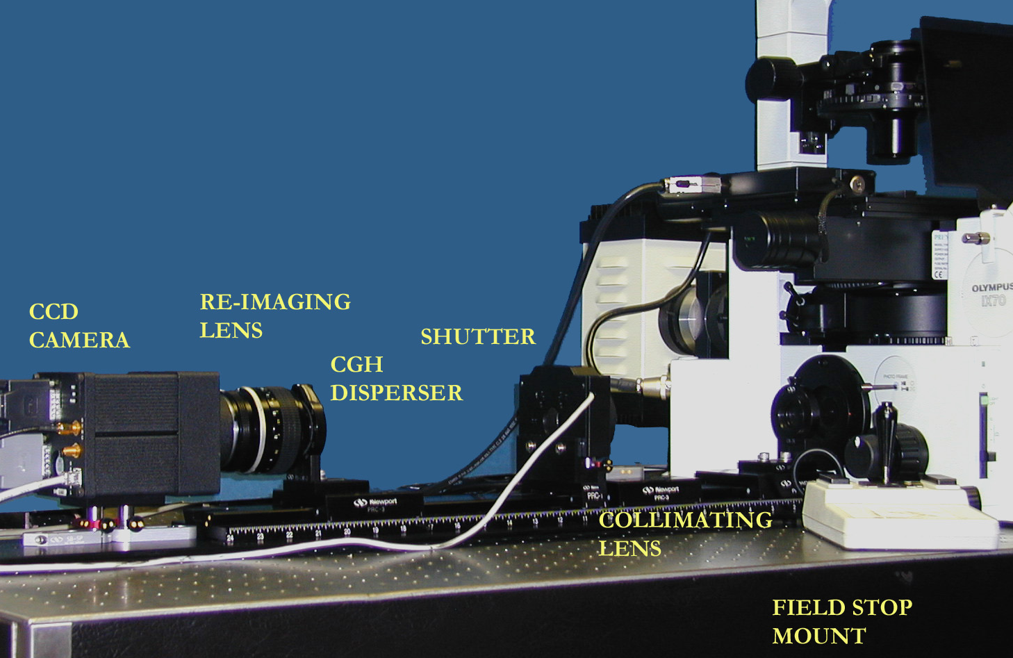
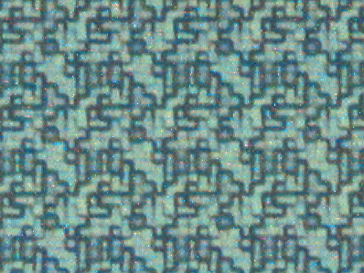
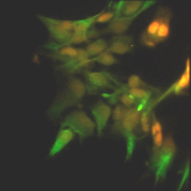
CTIS Computer Tomography Imaging Spectrometer Instrumentation at U. Arizona
Neena Imam Complex Systems Computer Science and Mathematics Division OAK RIDGE NATIONAL LABORATORY
Presented at RAMS Faculty Workshop Oak Ridge, TN December 10, 2007

Slide 4
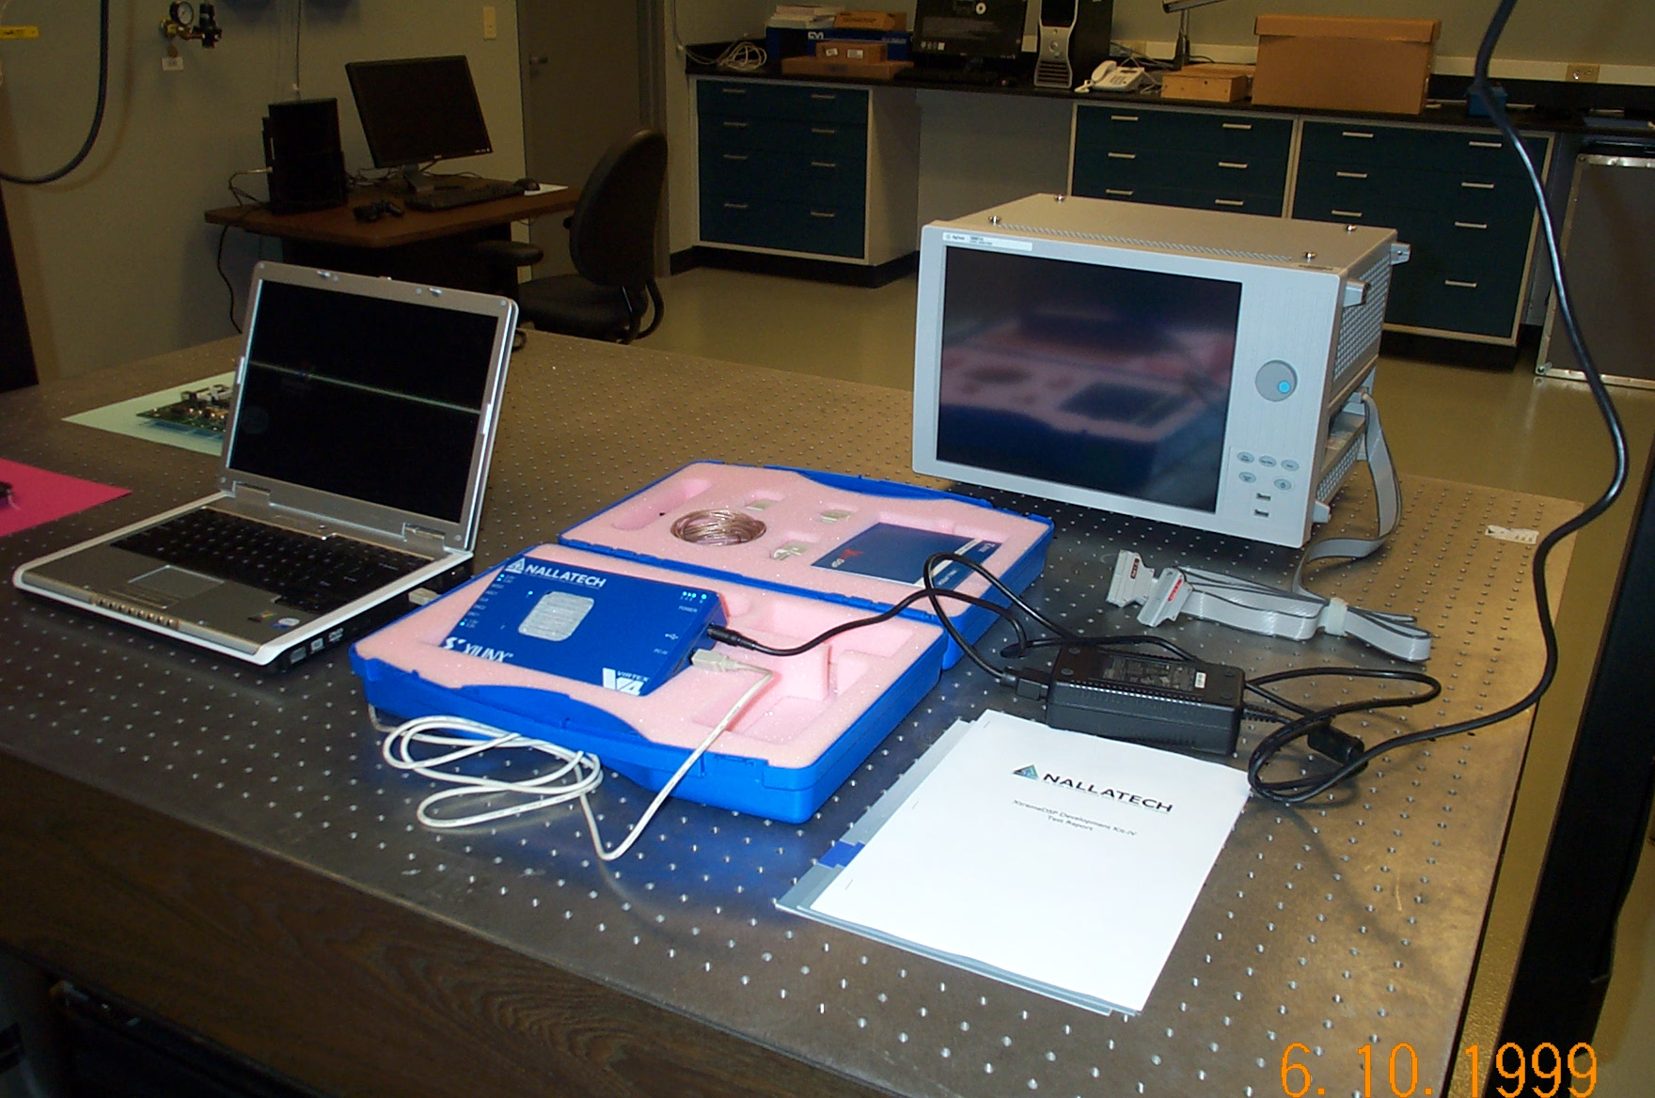
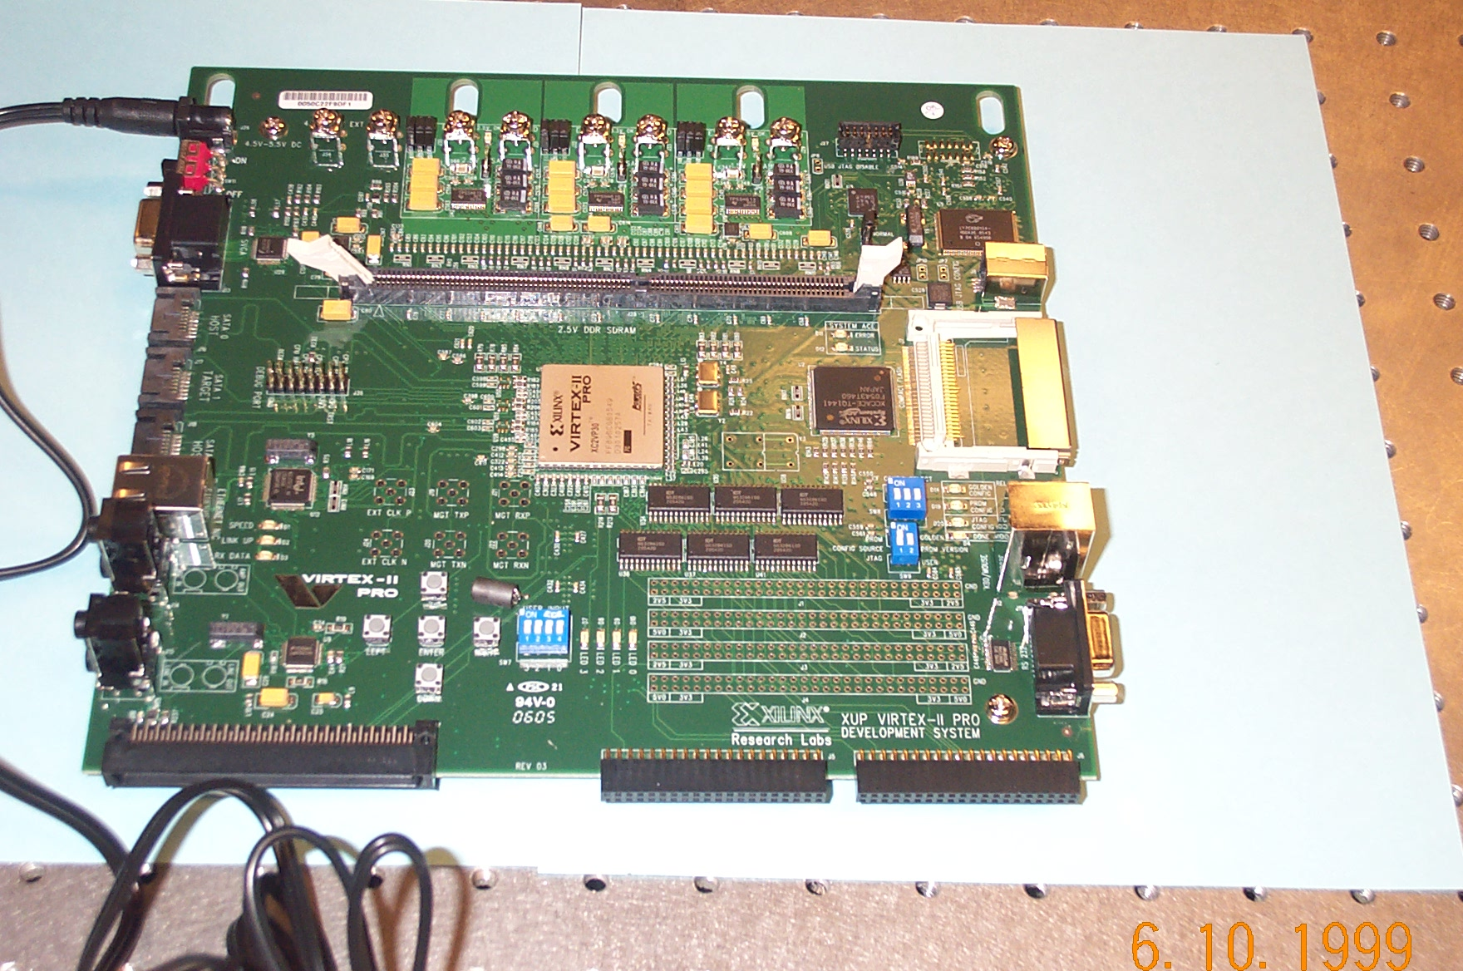
FPGA Signal Processing Station at SPECT Laboratory
Pegasus Demo Board with SPARTAN-2
Digilent VIRTEX-2 Development board
VIRTEX-4 XtremeDSPTM Development Board
Neena Imam Complex Systems Computer Science and Mathematics Division OAK RIDGE NATIONAL LABORATORY
Presented at RAMS Faculty Workshop Oak Ridge, TN December 10, 2007

